Slide 1

Radio Deployment System (RDS)
Fike, Thomas
Rocha, Katherine

Slide 2
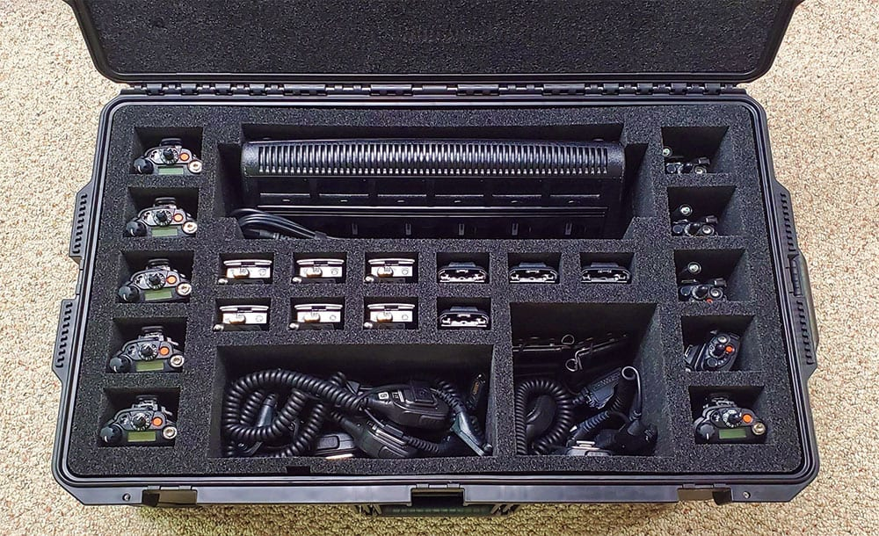
The Problem
In the communications unit on an incident it is normal for radios to be checked out and in to different personel. Today this is mostly done on paper using what are called T cards. This project will replace the T cards and allow for a digital system to track radios in and out of the comm unit.

Slide 3

UML
01

Slide 4
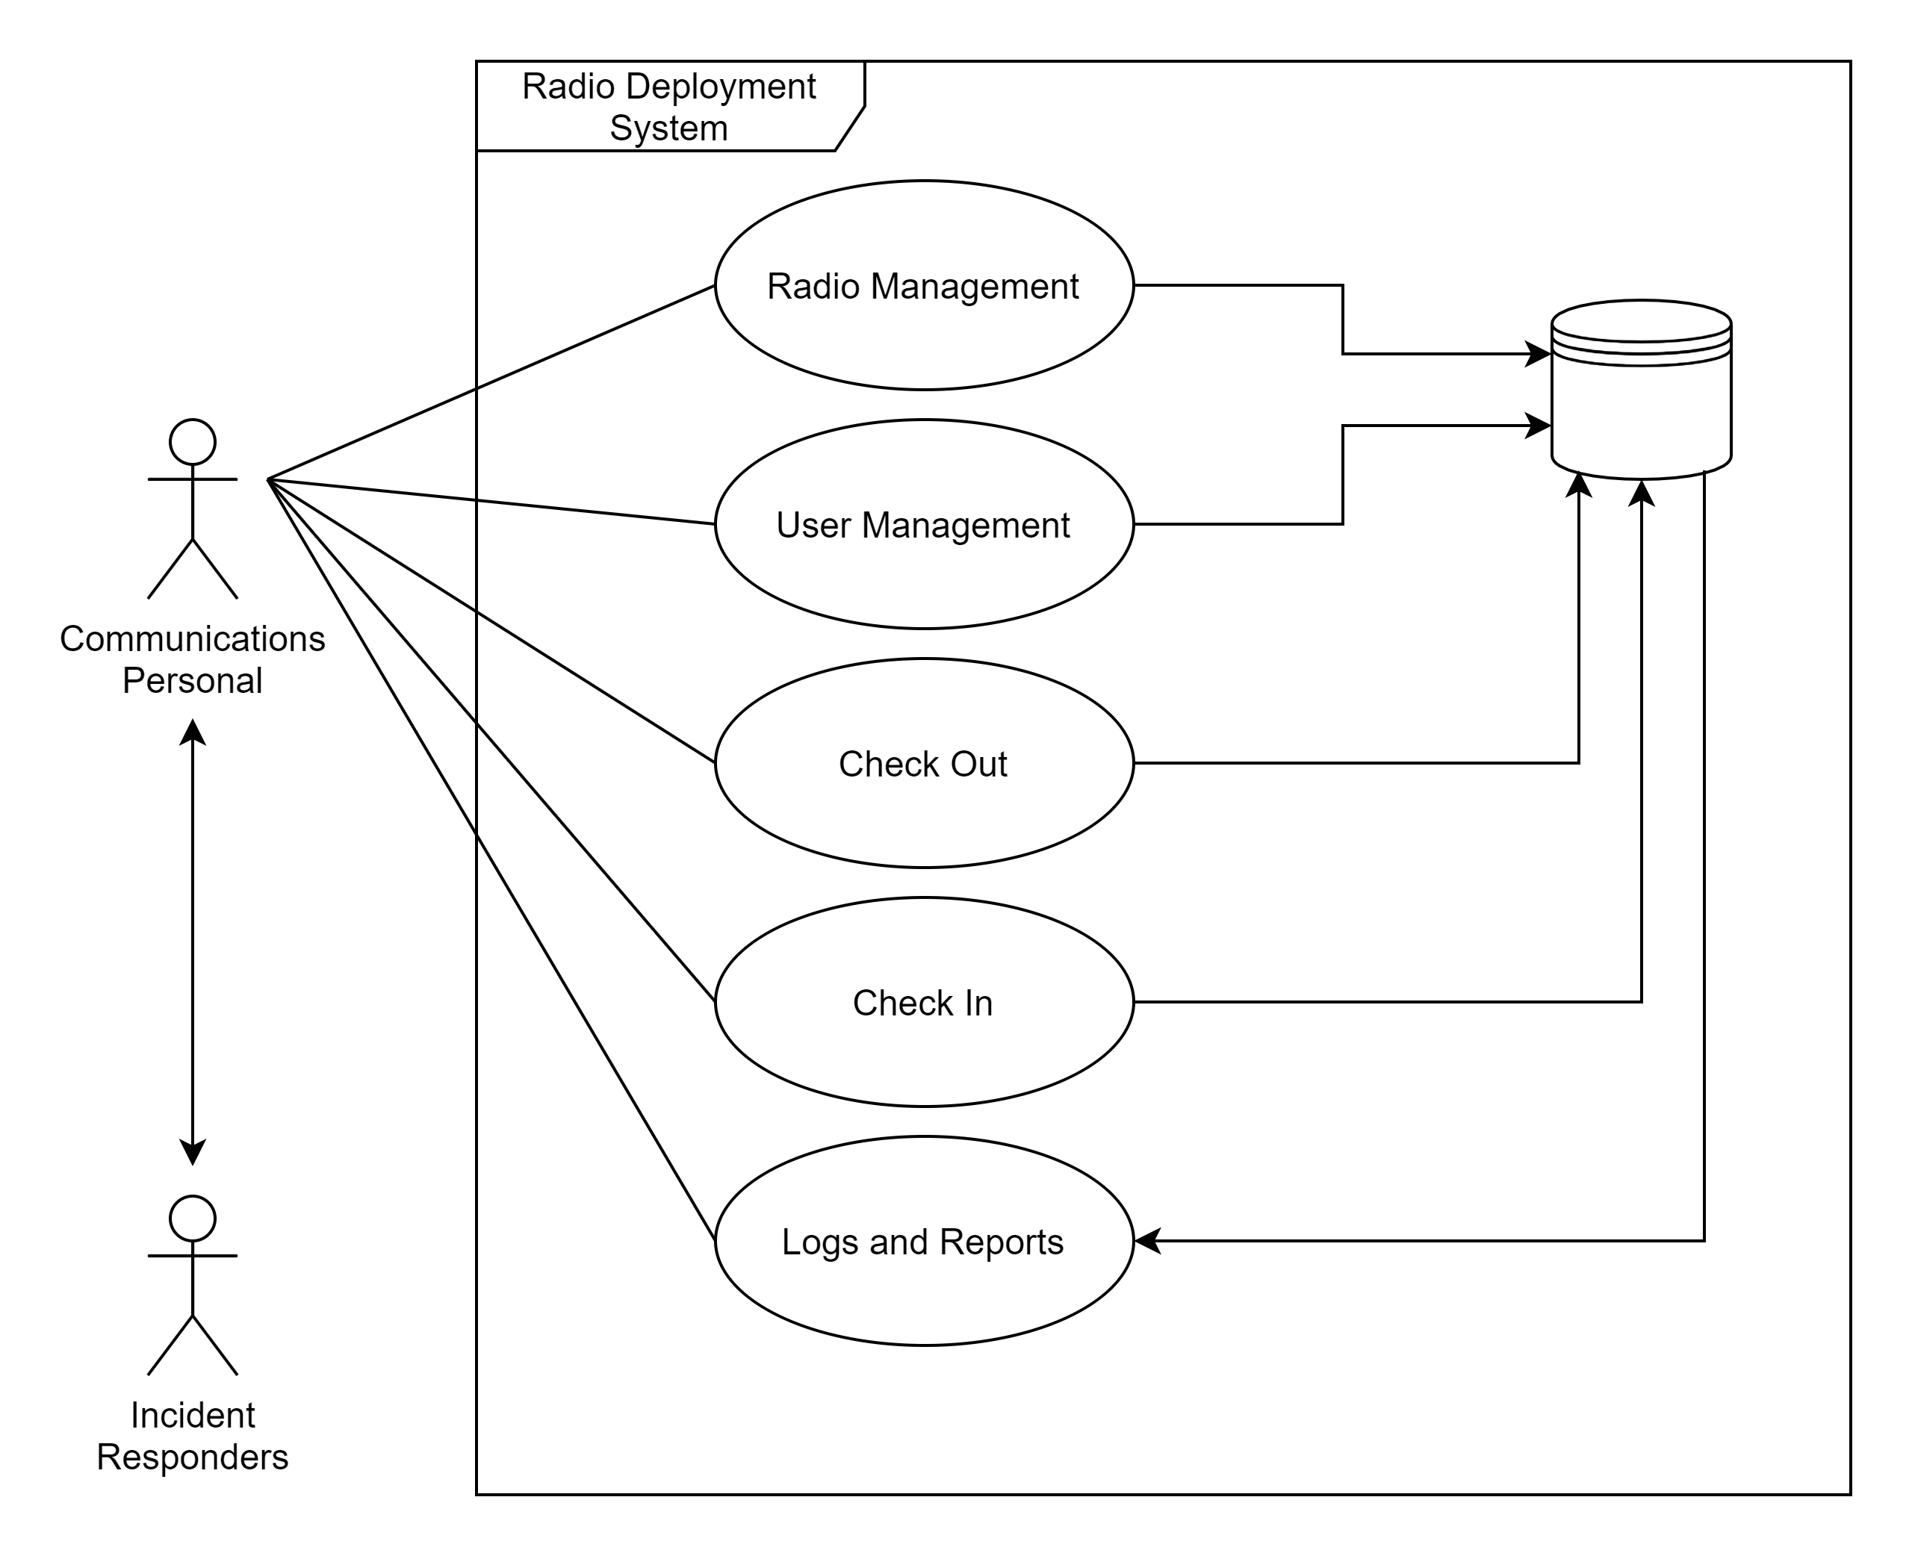
Use Case Diagram

Slide 5
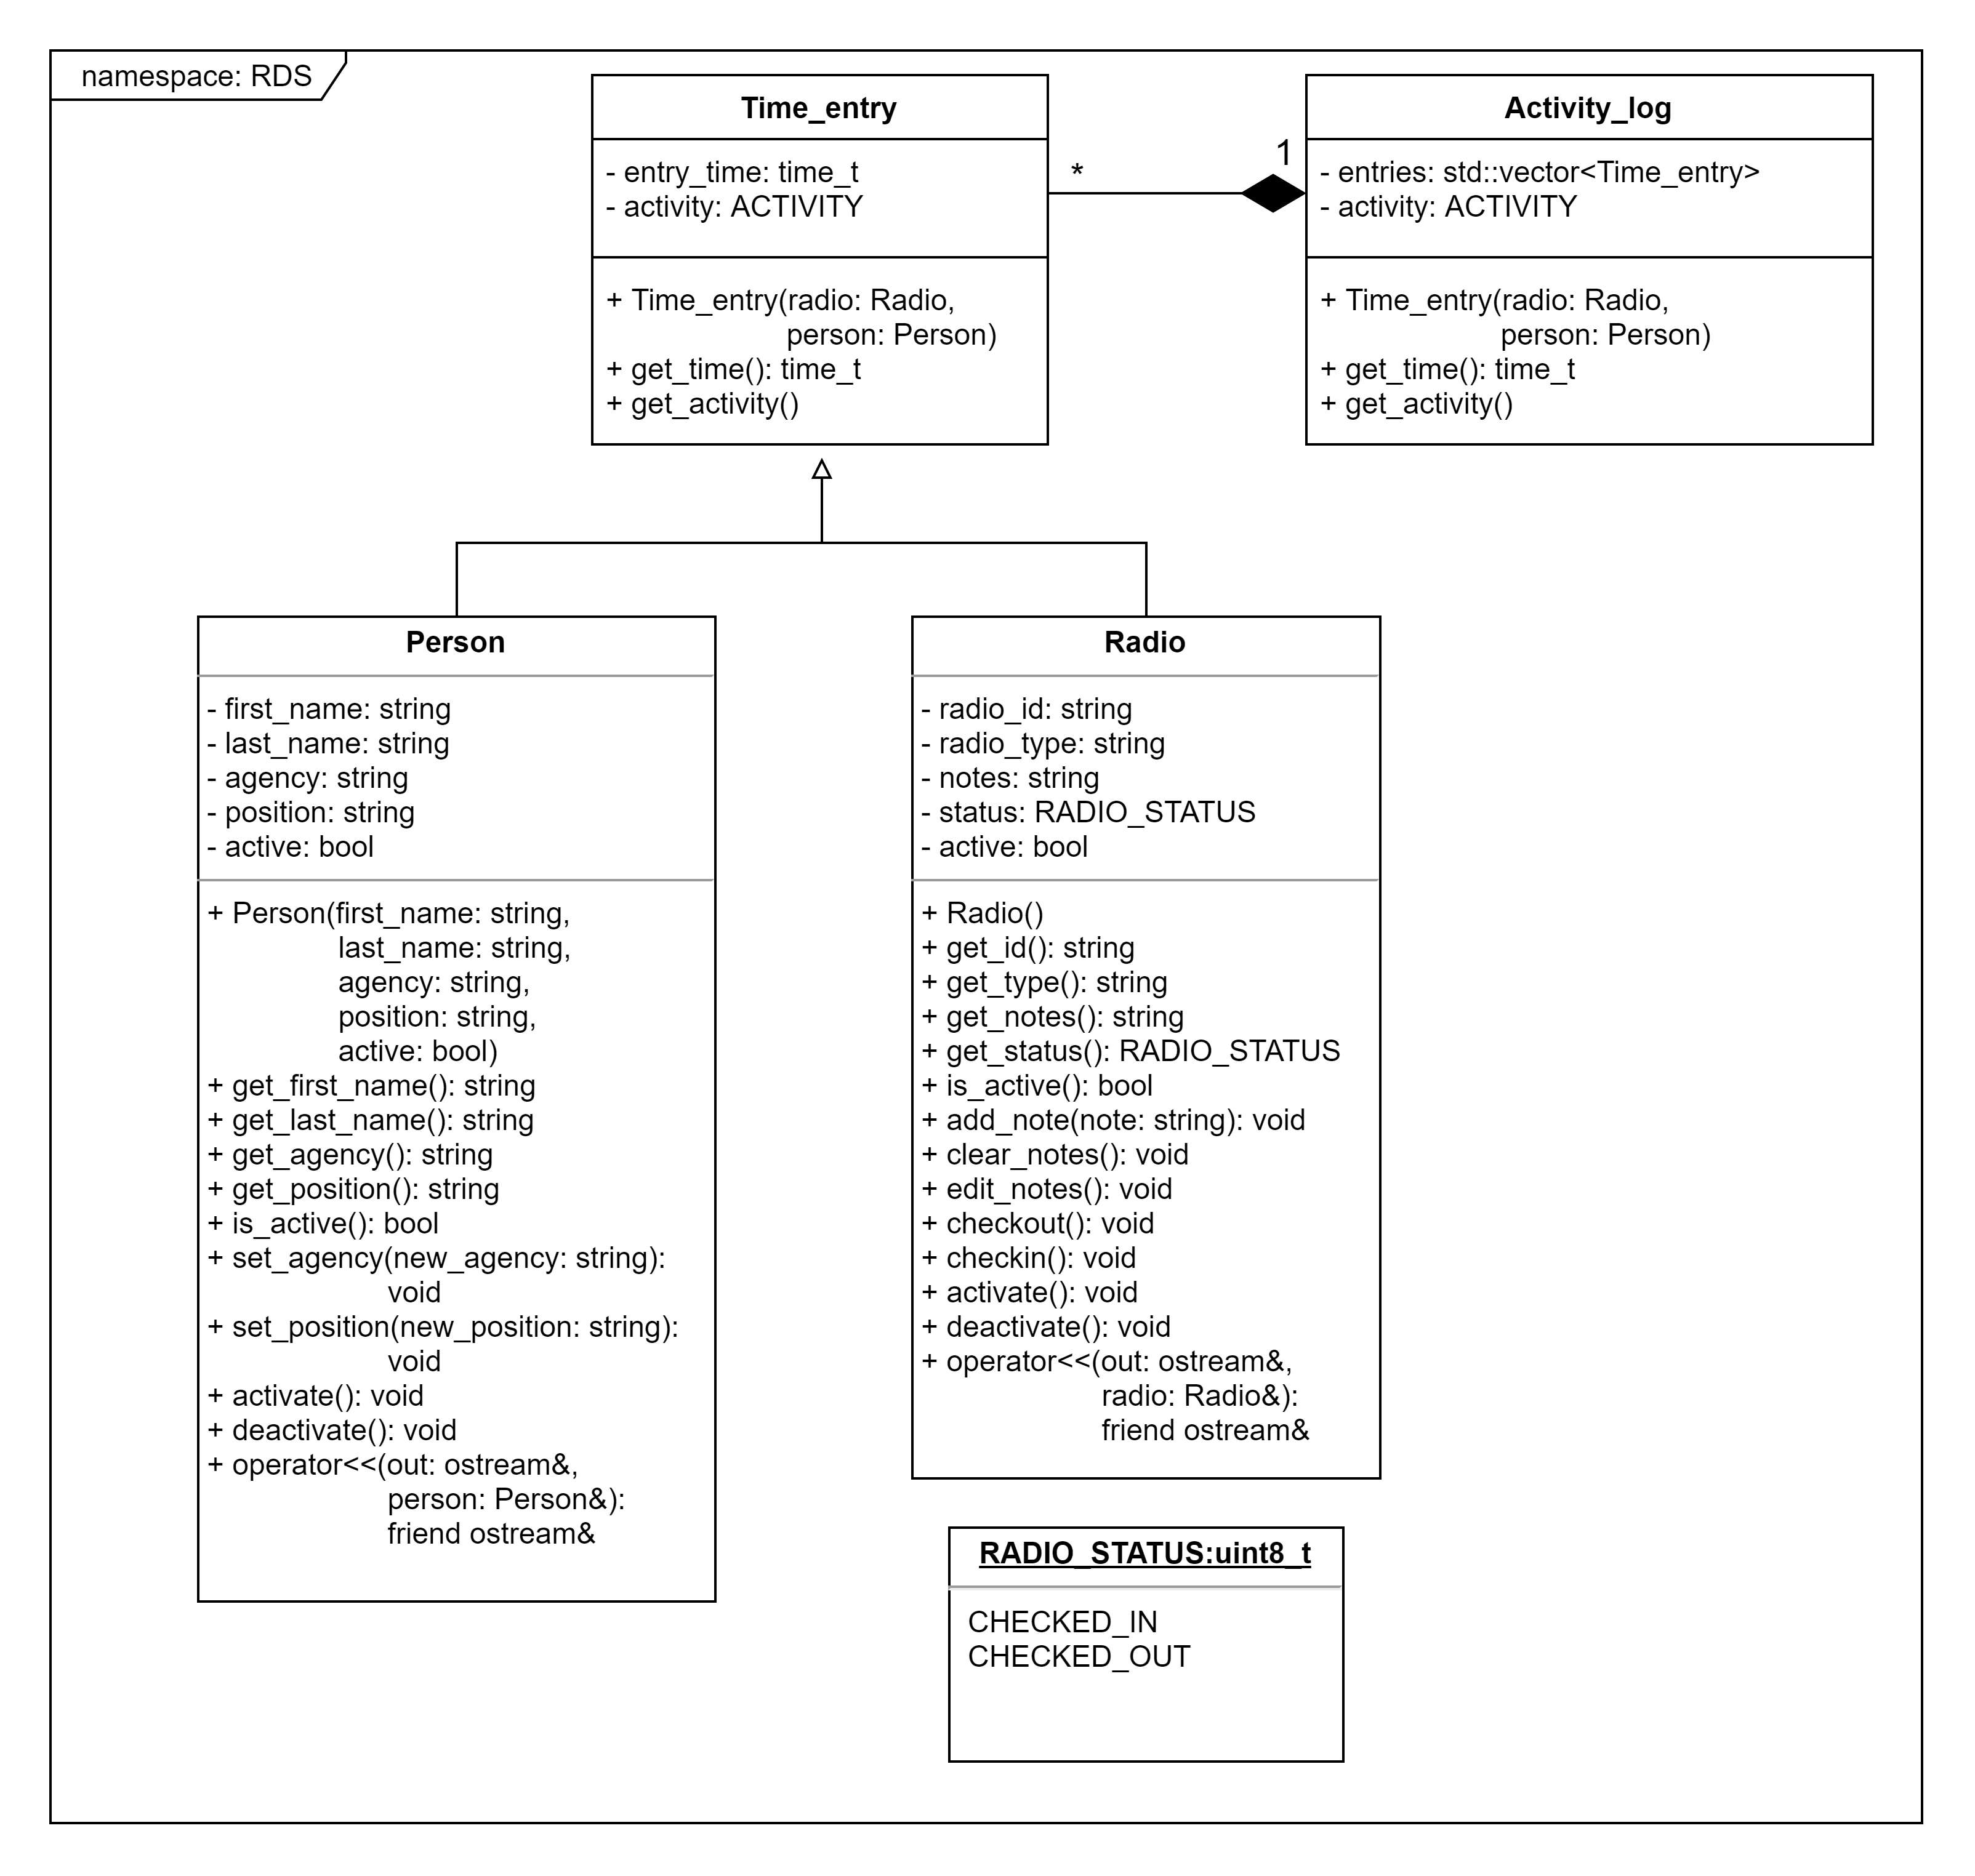
Class Diagram

Slide 6
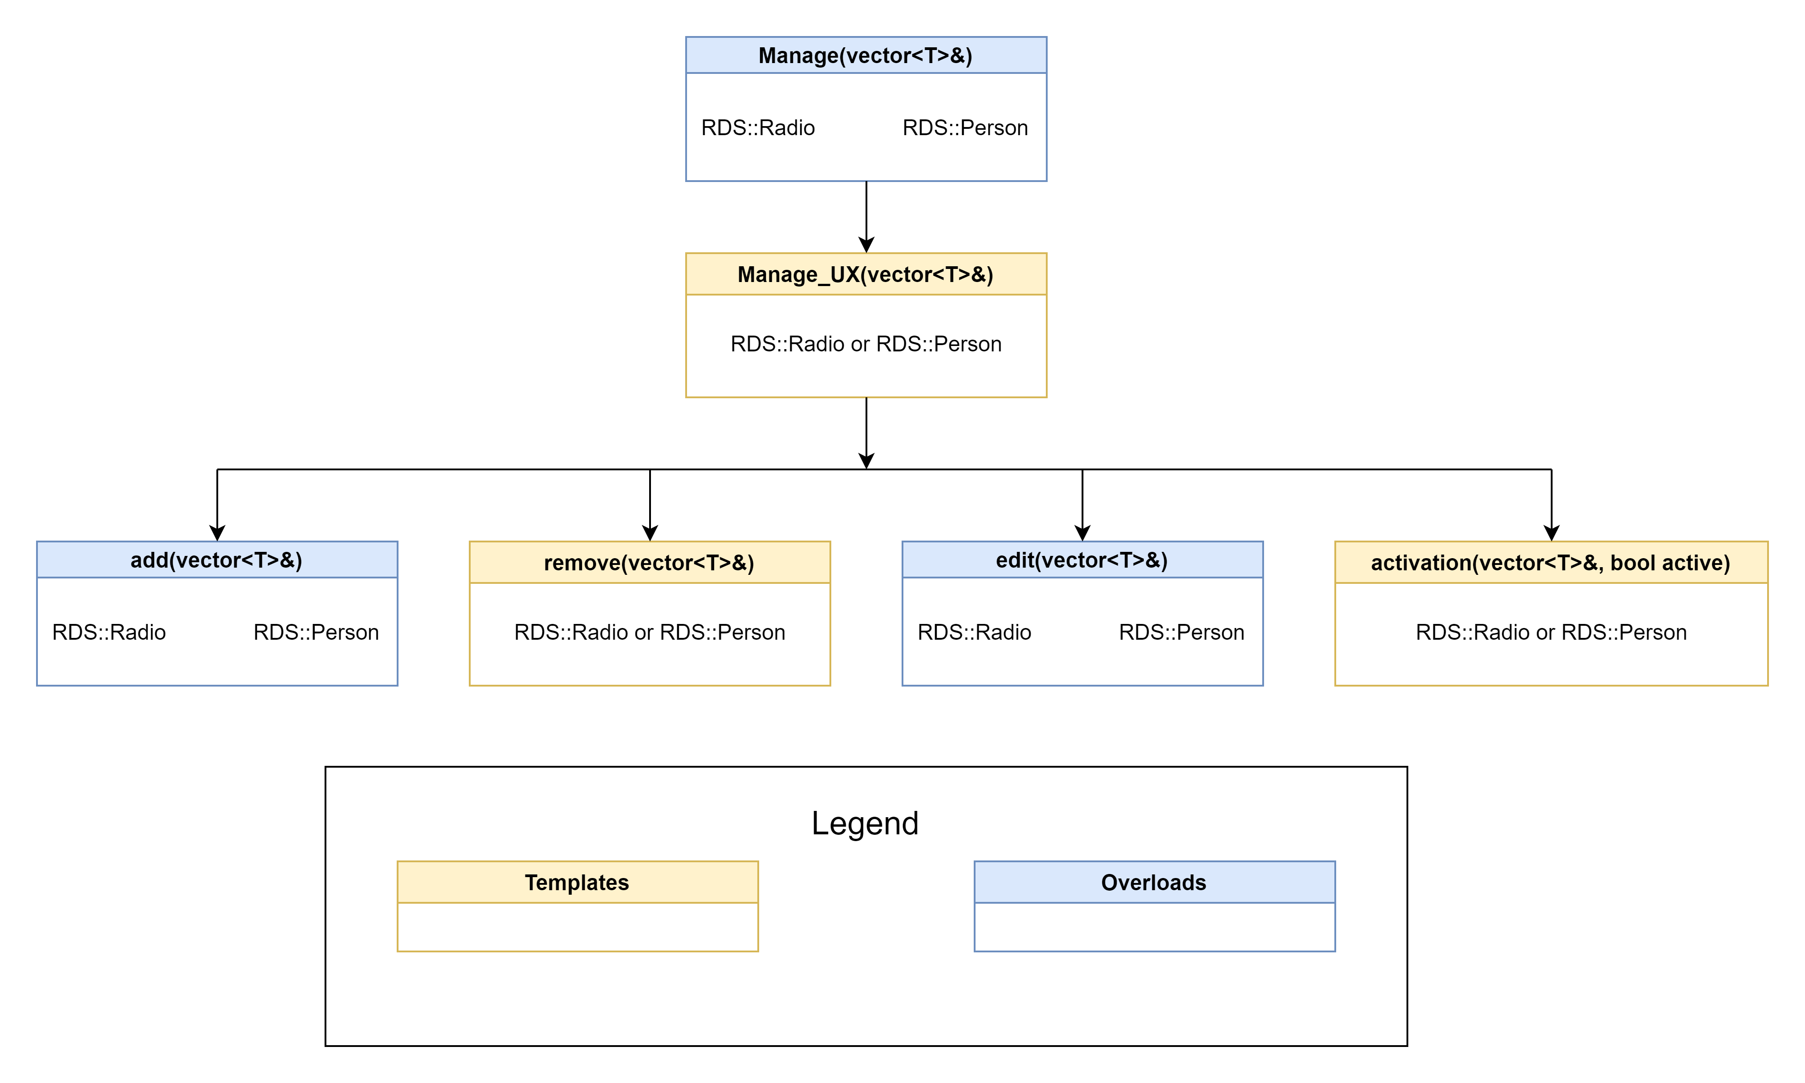
Management Function Diagram

Slide 7

Style Guide
02

Slide 8
Style is based off Google’s with a few tweaks.
Indention width is changed from 2 to 4 spaces.
The rule for short functions on one line is changed to only be true for functions inlined in a class declaration.
Comments are intended to be used as needed to explain the why of how something was done. (Used doxygen format)
Code should be written so the code explains itself instead of needing a comment to have it make sense.

Slide 9

Example Usage
03

Slide 10
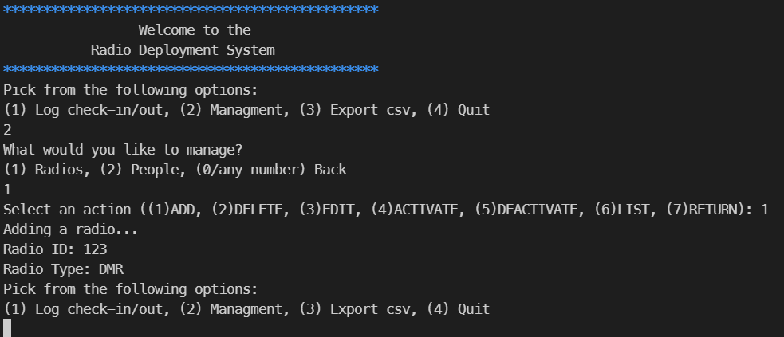
Initial Display

Slide 11
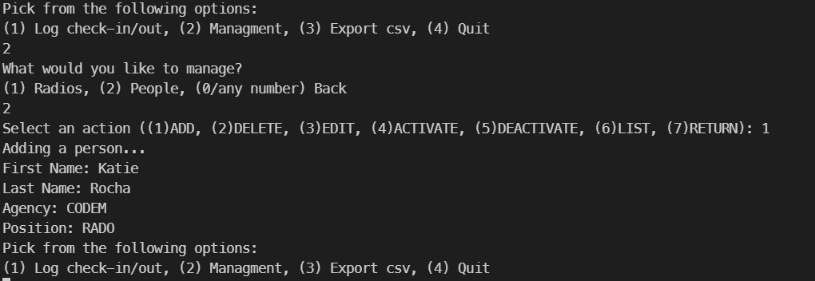
Management

Slide 12
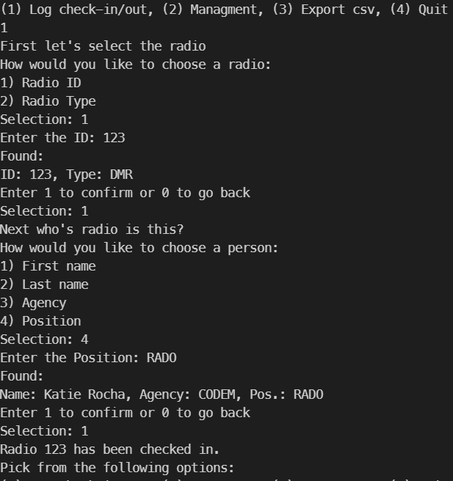
Log check-in/out

Slide 13
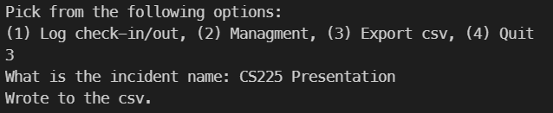
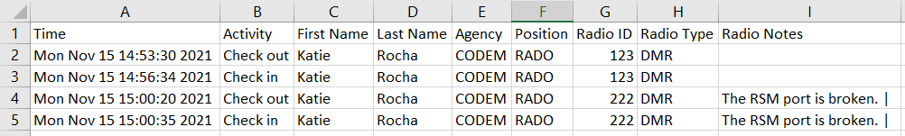
CSV File Creation

Slide 14
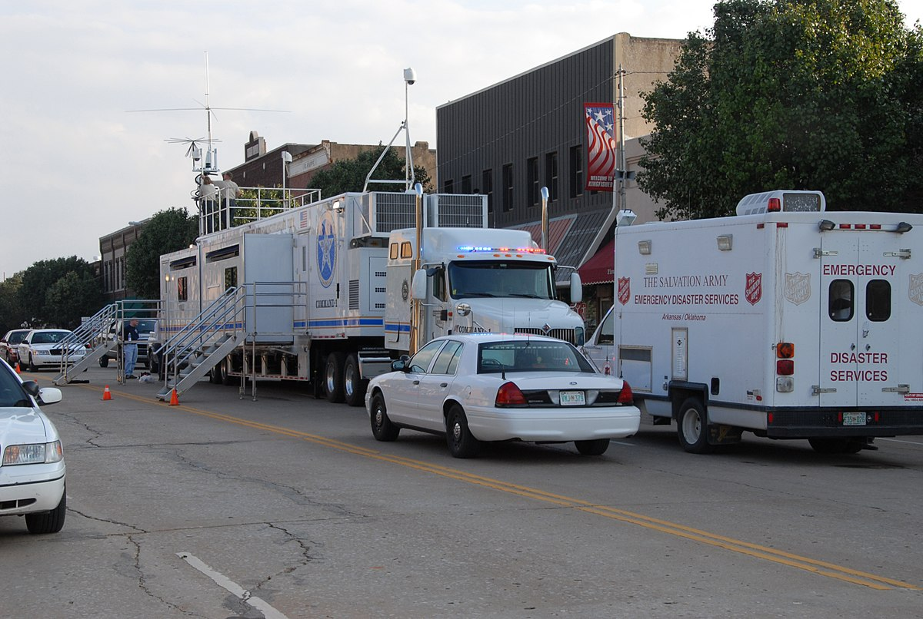
Potential Improvements
GRAPHICAL USER INTERFACE (GUI)
PORT TO DATABASE
DATA IMPORT SYSTEM
Improves typical use-case workflow
Easier to use
Better storage of data
Could allow for data to be stored externally
Many of the radios & people are known ahead of time
Prepopulating will save the end user time
Makes startup significantly faster

Slide 15

Lessons Learned
Meta Programming
Running External Programs
Pair Programming
Templates
Allows for reuse of code by different types
system()
Passes commands to system terminal
Ran bash script to open vim
Communicating Design Ideas
Updating other elements during design

Slide 16

Questions

Slide 17
Back-Up Slides

Slide 18
Notes:
Use Case Diagram

Slide 19
Notes:
Class Diagram

Slide 21
CREDITS
Credit for the presentation Template.
Presentation template by Slidesgo
Icons by Flaticon
Infographics by Freepik
Images created by Freepik

